Slide 1
PROJECT DEVELOPMENT

Slide 2
Objectives
Identify main features of the framework
Identify framework file structure
Identify framework database structure
Learn basic Smarty codes
Learn the process on starting on a new project
How to create new module
Standard Operating Procedure
Tips and Tricks

Slide 3
Features
PHP (scripting language)
MySQL (database system)
HTML (markup language)
Smarty (web template)
JQuery (javascript library)
Bootstrap (responsive design)
Aceadmin (template backend)

Slide 4

File Structure
Application (all php codes, controllers and models)
Skin (all html, scripts and styles)
System (system configuration)
Temp (temporary files)
Upload (files saved)
Config (system define configuration)

Slide 5
File Structure Application
Modules – controllers and models
frontend
backend
core
Hooks – globally used variables
Libraries – system configuration plugins

Slide 6
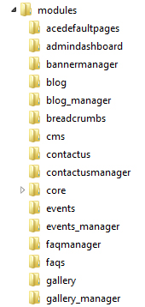
File Structure Application > Modules
Contains controller and model
blog
assigned to decide what to display in specific frontend module
blog_manager
assigned to decide what to display in admin panel module

Slide 7
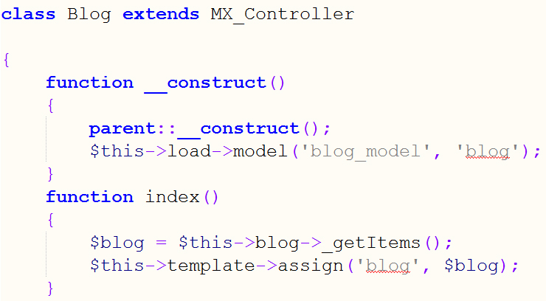
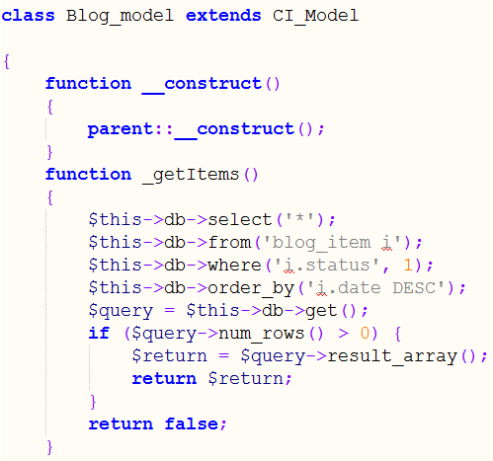
File Structure Application > Modules
Controller
Model
http://10.10.1.12/samplewebsite12/blog
http://10.10.1.12/samplewebsite12/administrator/blog_manager

Slide 8
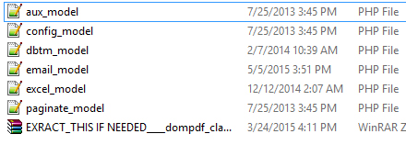
File Structure Application > Modules
Core
contains third-party plugins

Slide 9
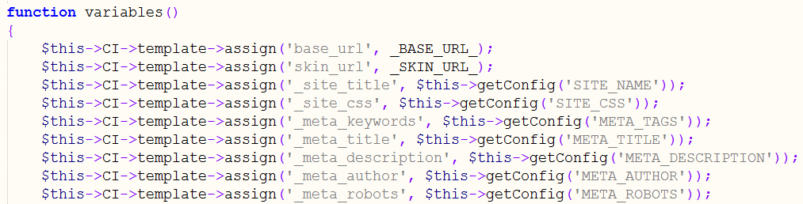
File Structure Application > Hooks
Globals
global variables setuped

Slide 10
File Structure
Application (all php codes, controllers and models)
Skin (all html, scripts and styles)
System (system configuration)
Temp (temporary files)
Upload (files saved)
Config (system define configuration)

Slide 11

File Structure Skin
Aceadmin – files for admin panel layout
vii_samplewebsite12 – theme files for frontend layout
email_templates – html files used for email

Slide 12
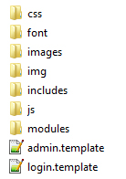
File Structure Skin > Aceadmin
login.template.html – template used for login
admin.template.html - template used for all pages of admin panel
includes - html segment files that can be fetched
js - primary and module’s scripts
modules - html files of module
css, font, images, img - used for designing and styling

Slide 13
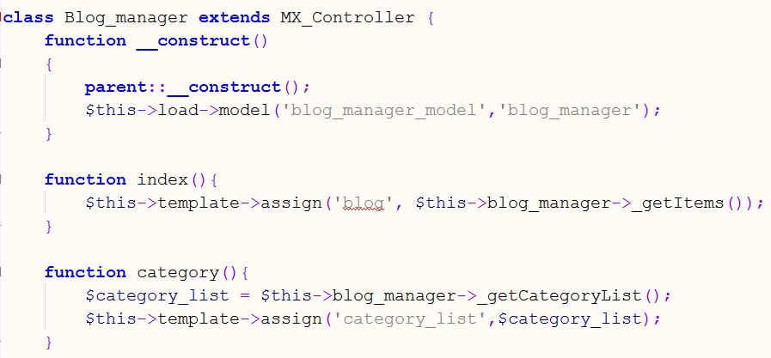
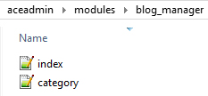
File Structure Skin > Aceadmin > Modules
blog_manager
controller
file name should always be the same as the controllers function name

Slide 14
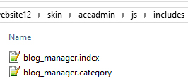
File Structure Skin > Aceadmin > JS
js includes
modules
file name should always be the same as the modules file name

Slide 15
File Structure Skin
Aceadmin – files for admin panel layout
vii_samplewebsite12 – theme files for frontend layout
email_templates – html files used for email

Slide 16
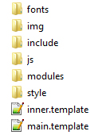
File Structure Skin > theme
main.template.html – template used for homepage
inner.template.html - template used for all pages of frontend
includes - html segment files that can be fetched
js - primary and module’s scripts
modules - html files of module
css, font, images, img - used for designing and styling

Slide 17
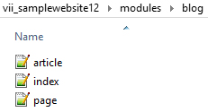
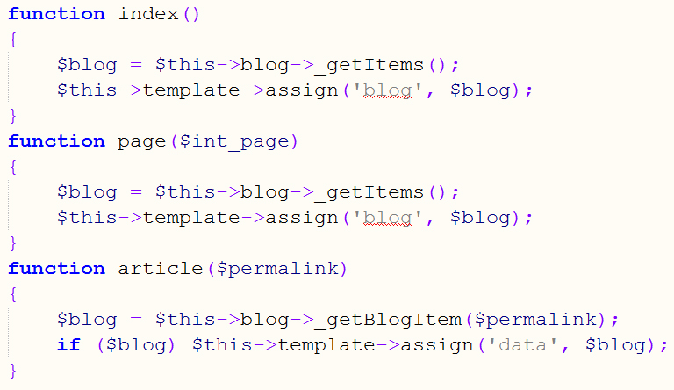
File Structure Skin > Aceadmin > Modules
blog_manager
controller
file name should always be the same as the controllers function name

Slide 18

File Structure Skin > Aceadmin > JS
includes
modules
file name should always be the same as the module name

Slide 19
File Structure
Application (all php codes, controllers and models)
Skin (all html, scripts and styles)
System (system configuration)
Temp (temporary files)
Upload (files saved)
Config (system define configuration)

Slide 20
File Structure Temp / Uploads
Temp
Images - initial images from uploads functions
Uploads
images - transferred images from temp
download_files - downloaded files
files - other downloaded files

Slide 21
File Structure Config
Define set up for :
Admin Theme
DB Username
DB Password
DB Database
Base URL
Theme

Slide 22
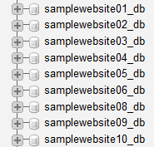
Database Structure Database
Database name should always be the name of the project + “_db” at the end

Slide 23
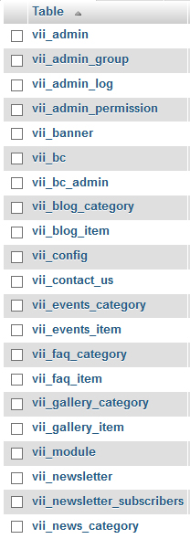
Database Structure Tables
Database table name should always use appropriate to module or functionality
Other tables can also be a reference

Slide 24
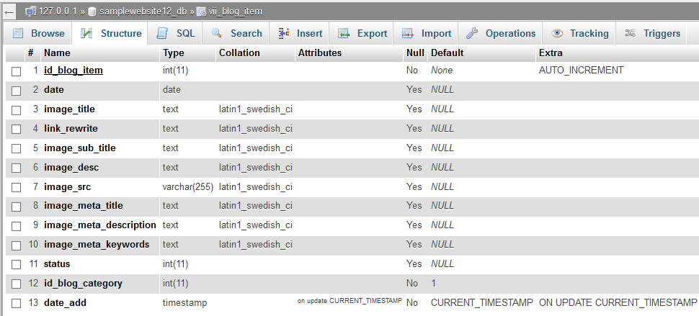
Database Structure Table

Slide 25
Database Structure Table (cont…)
Primary ID of the table should always start with “id_” + table name
Primary ID should always be in auto increment
Primary ID should always have int (11) type
Primary ID cannot be null

Slide 26
Database Structure Table (cont…)
Use VARCHAR (255) type for users name, email, passwords, ip address, link rewrite, reference nos. and other fields that should not have reach 255 characters
Use TEXT type for titles, subtitles, descriptions, images, keywords, address, subjects, messages, contact nos, and other fields that might reach over 255 characters
Use INT (11) type for ids, age, status, flag and other fields that will not require letters
Use DATETIME type for date add, date updates, birthdate, log date, and other fields that will only have dates as value

Slide 27
Basic Smarty Codes Set Up
From controller, fetch from database or any value to be displayed in the html
Assign a variable name for smarty to be used

Slide 28
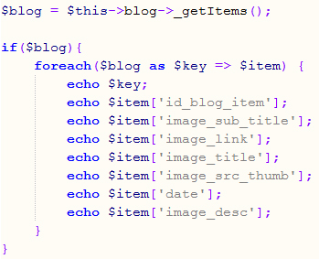
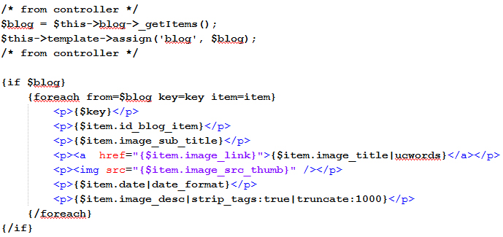
Basic Smarty Codes Set Up (cont…)
PHP
SMARTY

Slide 29
Basic Smarty Codes Set Up (cont…)
$blog - is a smarty variable code that holds the values and contents
{if $blog} {/if} - check if $blog has value
{foreach from=$blog key=key item=item}
$blog - array
$key - holds the index count (from 0 to n)
$item - value of the current element
$item.image_title - holds the title value

Slide 30
Basic Smarty Codes Set Up (cont…)
Comparison Operators
{if $sample_val > 1} - if greater than
{if $sample_val < 1} - if less than
{if $sample_val eq 1} - if equal
{if $sample_val neq 1} - if not equal
{if !$sample_val} - if false
{assign var="month" value=$sample_val}
{$month} - this will display the value assigned

Slide 31
Steps in creating new project
Copy the files in the latest Plug & Play Installer in xamp files
Create database
Run the installer based from project url link
Enter required fields
Done
For more details open Set up Local Development.docx

Slide 32
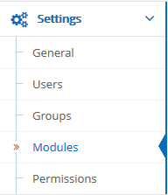
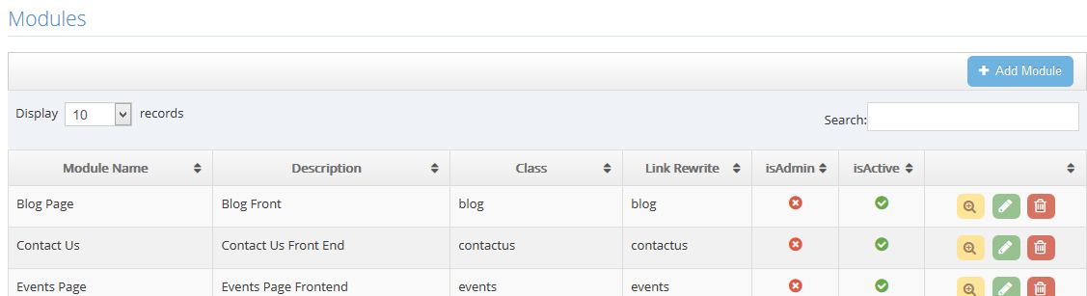
Steps in creating new module
Login to administrator
Click modules under settings
Click add module

Slide 33
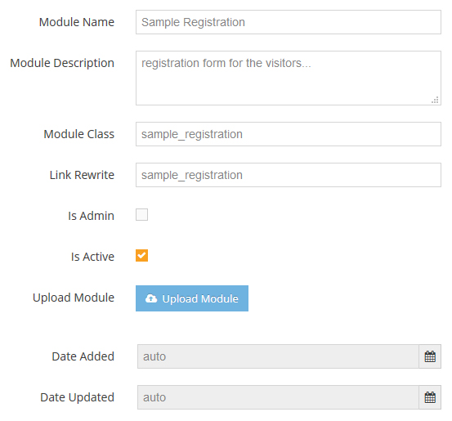
Steps in creating new module (cont…)
Fill up all fields
Module class should always be the same with Link rewrite
Check is Admin if the module is for admin use only

Slide 34
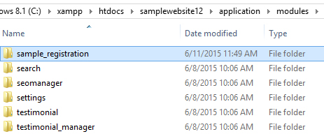
Steps in creating new module (cont…)
System automatically creates folder with controller and model

Slide 35
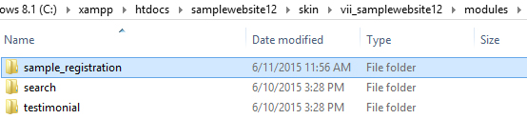
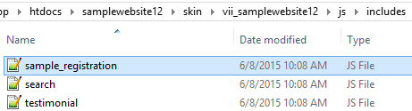
Steps in creating new module (cont…)
Create skin module folder and files

Slide 36
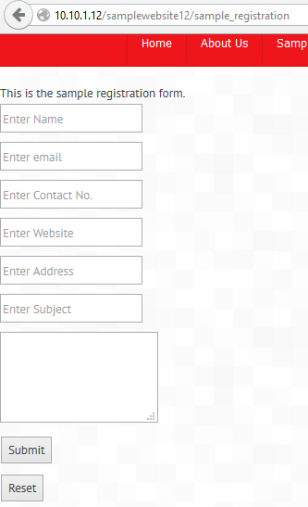
Steps in creating new module (cont…)
Voila! New module created
Same process in creating new module for admin

Slide 37
Standard Operating Procedure
PLEASE try your code first or do trial and error before consulting or GOOGLE is your friend, my friend
IF found an HTML codes that seems wrong please use appropriate code for it, again GOOGLE is you friend
REMOVE UNNECESSARY codes if not used and do NOT COMMENT if it will NEVER ever be used
REMOVE UNNECESSARY lines instead use only INFORMATIVE comments for BETTER development/design references

Slide 38
Tips and Guide
ALWAYS BEAUTIFY if you want to organize the .html, .js codes (jsbeautifier.org) and .css (html.fwpolice.com/css) and .php (phpbeautifier.com), please help those who can't read your codes, FAVORITE/BOOKMARK those links
ALWAYS use proper code line TABULATION .html, .js, .css and .php, those beautifier will really help or prepare to find codes in disorganized way
ALWAYS create LOCAL BACKUP a file/s or folder/s before debugging/editing per day, at least you have the latest backup up before you make changes

Slide 39
Tips and Guide
REMOVE ALL UNNECESSARY FILES for easy viewing of files after designing or developing (ex. Contactus_model-final1.php, Contactus_model-finalfinal.php index-backup.html, etc.)
IF error found ALWAYS CHECK IF YOUR SYNTAX CODES are correct, ask a friend and lastly GOOGLE is your friend, my friend

Slide 40
Tips and Guide
- Press ctrl + "F" , a pop up FIND will appear, use it to find some inquires here (ex. find "link"), then press F3 for faster find
to collapse all html tags (Ex. <p></p> , if(){}), press alt + 0
NEVER use direct link or url of the website in html and js codes
When beautified always CHECK the smarty codes curly braces {, } should have NO space before and after see examples codes here

Slide 41
Tips and Guide
Please see SMARTY.NET for more references
ALL themes may have different design and some codes might need to adjust
CHECK config.php if CORRECT _BASE_URL_ , _THEME_
please CHECK/DEBUG the codes first

Slide 42
Tips and Guide
most of the time there will only be main.template.html, inner.template.html and error.template.html
New template for specific module pageare special cases
the rest of the pages will be inside modules, ex. forms, dynamic display of item name, includes folder or part of CMS page (http://[IP ADDRESS HERE]/[PROJECT NAME]/administrator/pages)

Slide 43
Tips and Guide
As much as possible NEVER use # in an anchor html tags, this will redirect to ERROR page MOST of the time, REPLACE it with javascript:; instead (Ex. <a href="#"></a> <==BAD, <a href="javascript:;"></a> <==GOOD)

